Slide 1

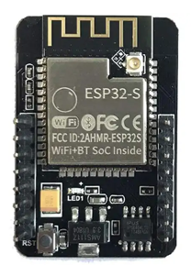
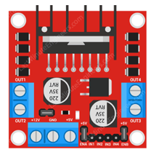
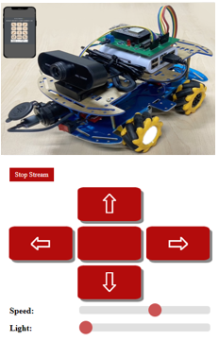
WebSocketEventGet Query string from the request URL
192.168.4.1
Car Control via Web Socket
192.168.4.1/CarInput
event data:
"MoveCar","1"
"Speed",value
"Light",value
Motor Drive signal
Client
Camera Stream via Web Socket
Access point / Server

Slide 2
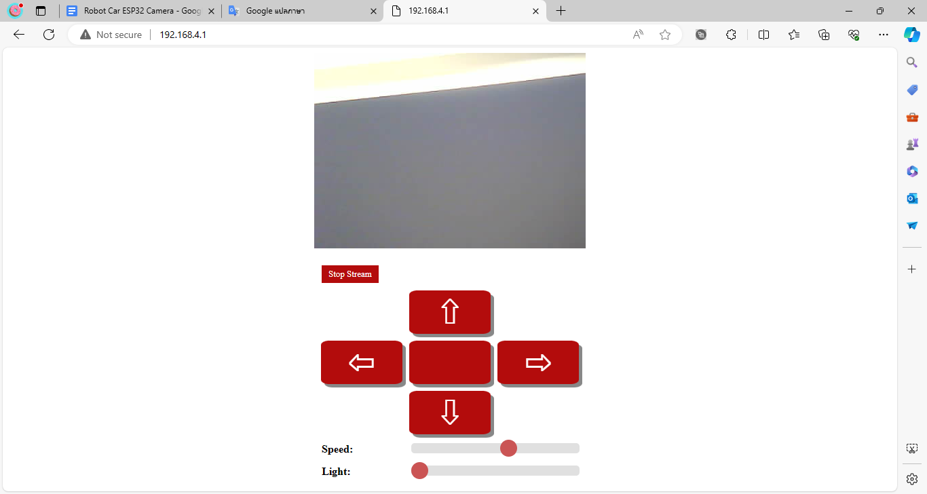
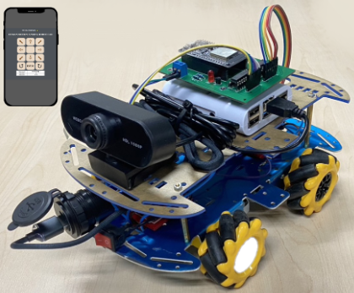

Slide 3
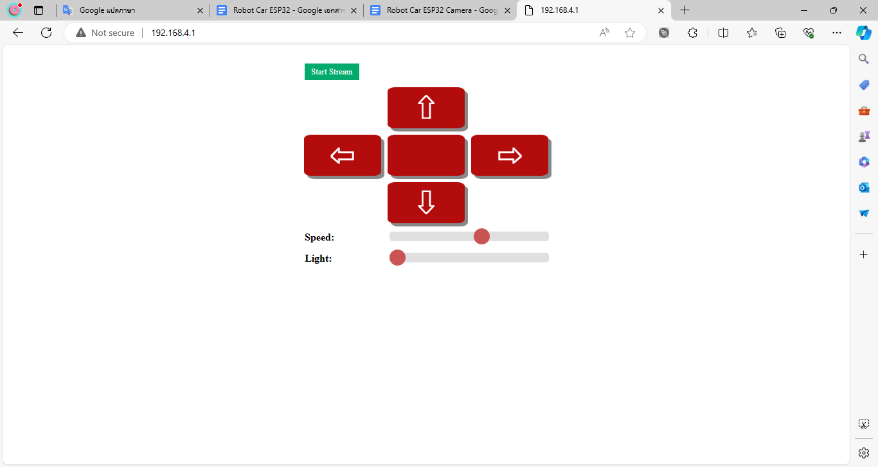

Slide 4
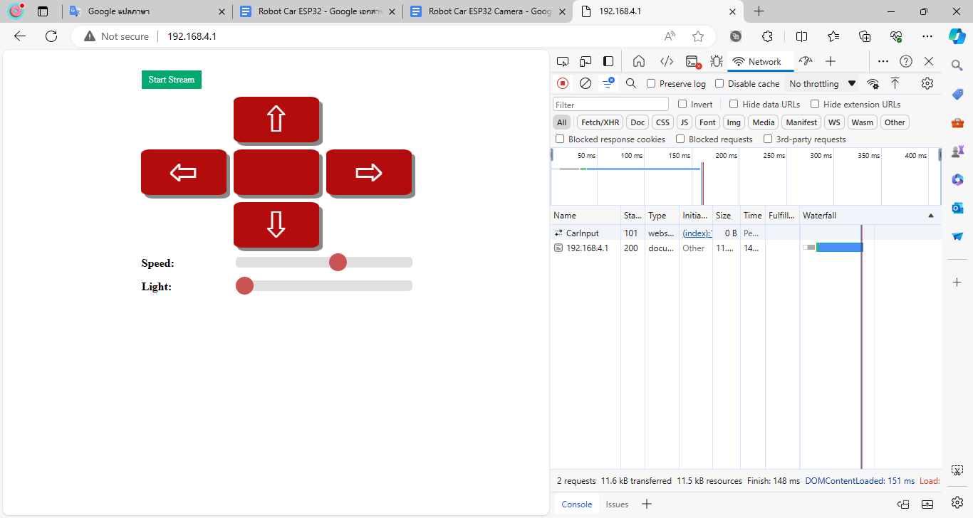

Slide 5
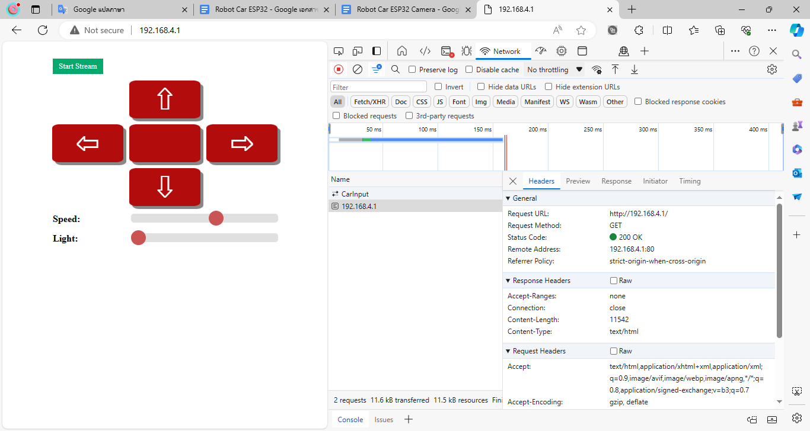

Slide 6
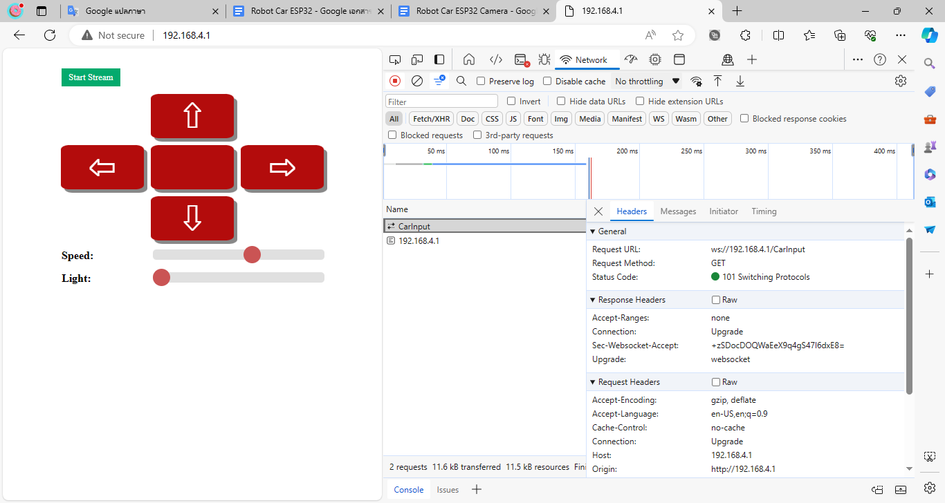

Slide 7


Slide 8
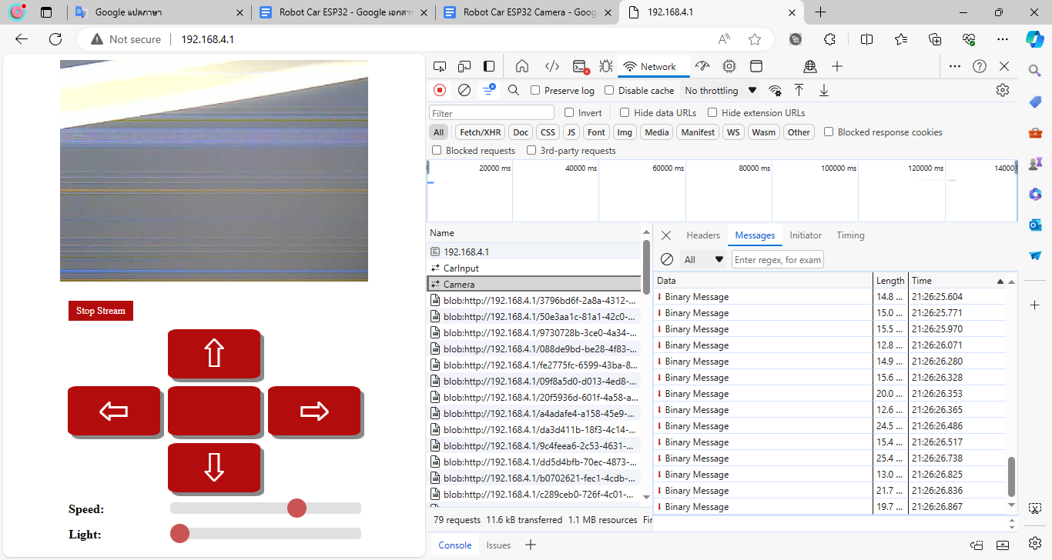

Slide 9
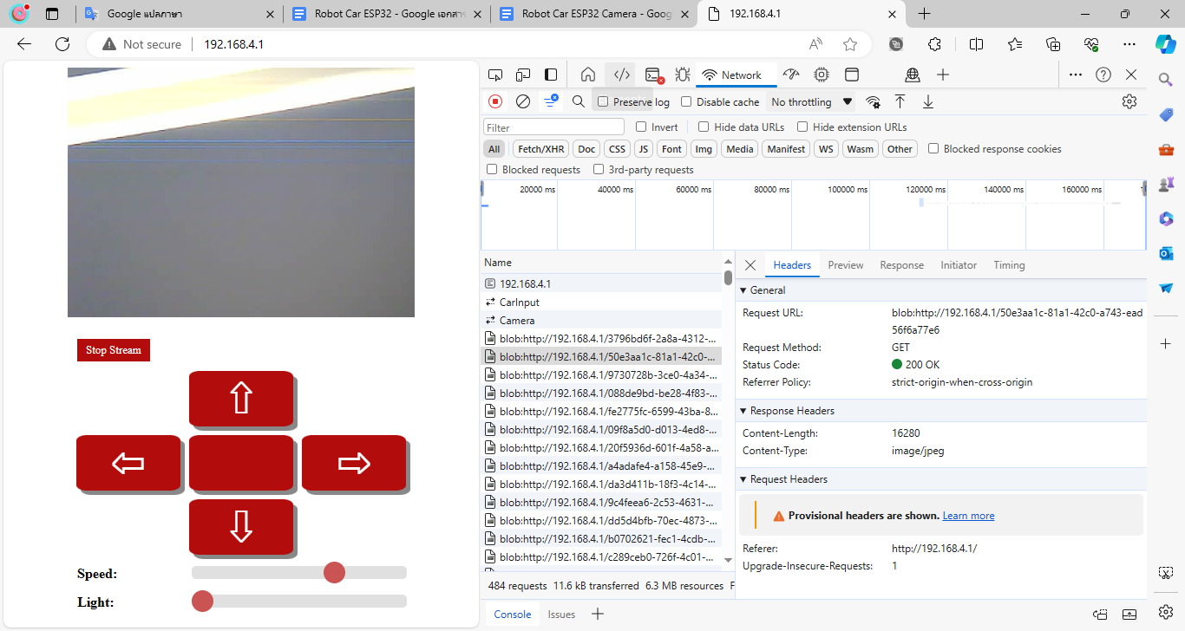

Slide 10
